Slide 1


Slide 2
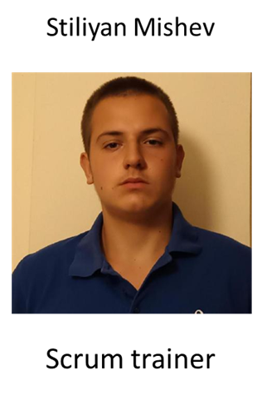
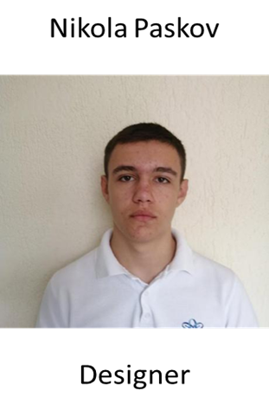
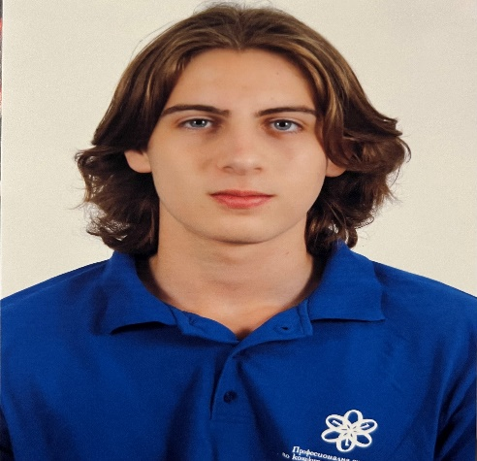

Our Team
Martin Velkov
Martin Stoyanov
Backend developer
Backend developer

Slide 3

OUR IDEA

Slide 4
STAGES OF DEVELOPMENT
1
3
To come up with an idea
Website and app development
2
4
Create design
Presentation

Slide 5

USING PROGRAMS

Slide 6

Let's take a look
at the site and the app

